Slide 1

YouTube Trending Videos
Team Members: Vandana Anand, Daniel McDonough, Krystal Grant
Notes:
I don’t really know what theme to use so if anyone wants to change it that’s completely fine

Slide 2

Hypothesis
We hypothesize that US trending videos on Youtube about current events come from and are viewed mostly from independent second hand new sources such as vloggers and other channels (Philip Defranco, Late Night Shows, etc), rather than mainstream news organizations (NBC, CBS, FOX, etc).

Slide 3
Definitions
Mainstream News Sources:
A source that most have heard of and consider reputable. May have other mediums of News than just social media.
Independent News Sources:
A source that has no vested interest in a written topic and therefore it is commonly expected to describe the topic from a disinterested perspective. Small number of individuals that use their own video as source

Slide 4

Social Significance
This experiment is significant because with so many second hand news sources it can increase the spread of misinformation on important topics which can later influence decisions or opinions on these topics

Slide 5
Methodology
Obtain Raw Data from our data set
Organize Data to be between November 2017 and February 2018
Extracted the Videos from the chosen 3 categories: Travel and Events(19), News and Politics (25), Science and Technology (28)
Parse for what qualifies as News (ie remove Superbowl Commercials, and Movie Trailers)
Research the uploaders’ channel to determine classification as a Mainstream or Independent news source.
Calculate and compare the averages of views of Independent and Mainstream news.
Raw Data Set: https://www.kaggle.com/datasnaek/youtube-new

Slide 6
Assumptions
19 - Travel & Events
21 - Videoblogging
22 - People & Blogs
23 - Comedy
24 - Entertainment
25 - News & Politics
27 - Education
28 - Science & Technology
29 - Nonprofits & Activism
Youtube has not explicitly stated what dictates a view, however it is known that Youtube verifies all views after 300 and check proportional watch time to overall video time.
Views are from all over the world but are trending in America
To constitute as a current event/news the video has to be within the following boundaries
Must affect society as a whole
Ie. DIY and Unboxing videos do not count
The category given to the video are absolute and accurate
The difference between Independent and mainstream news Organizations are determined by all the following criteria:
Mainstream news organizations are “grand” in the sense that they cover mediums other than Social Media
Independent news sources are smaller in that they may only have Social Media and one other medium and are run by a few members
Mainstream news is frequently updated

Slide 7
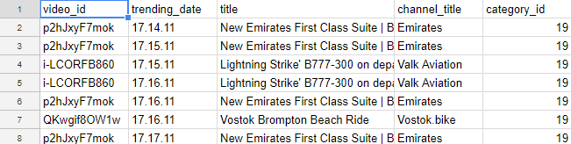
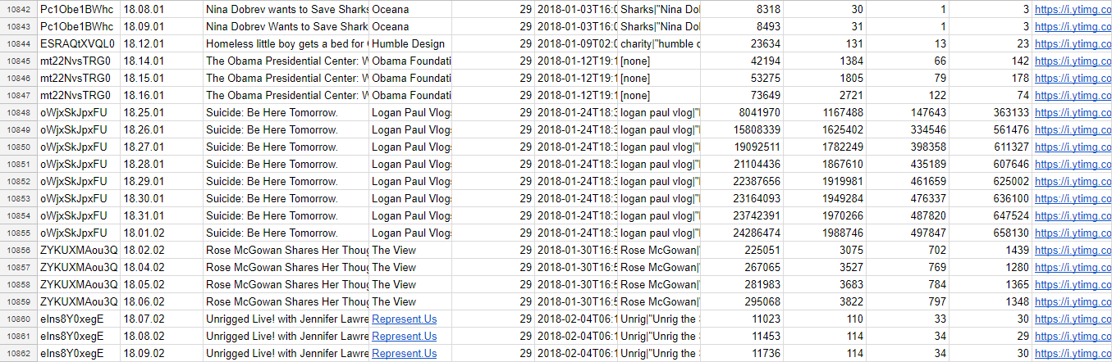
Raw Data Set
...

Slide 8
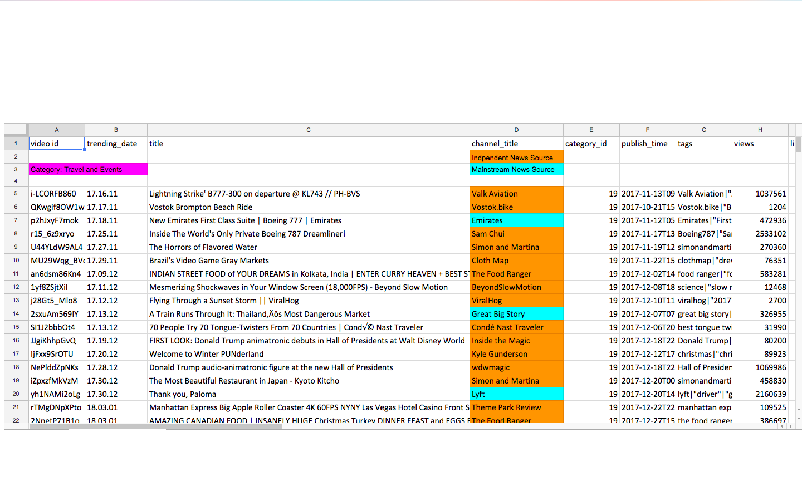
Sorted Data:
https://docs.google.com/spreadsheets/d/1yx8ALrBK8MU2be3H7RKKJaBcslIXcED2YMbr8E8E16o/edit#gid=0

Slide 9

Results: Travel and Events
 | Independent Sources | Mainstream Sources
# of videos | 24 | 15
Average # of views | 429,483.67 | 2,030,372.40
Does this support our hypothesis? | No (P>0.1)

Slide 10

Results: News and Politics
 | Independent Sources | Mainstream Sources
# of videos | 7 | 172
Average # of views | 167,298.43 | 284,794.12
Does this support our hypothesis? | No (P>0.1)

Slide 11

Results: Science and Technology
 | Independent Sources | Mainstream Sources
# of videos | 13 | 26
Average # of views | 448, 922.15 | 1,941,732.92
Does this support our hypothesis? | No (P>0.1)

Slide 12
Results:
We used 257 data points overall
Tested hypothesis over 3 categories: Travel and Events, News and Politics, and Science and Technology
The average number of views for mainstream news source videos is significantly greater than for independent news source videos
The P value is greater than the a statistically significant confidence value for disproving a null hypothesis. So, we have very little confidence to prove our hypothesis accurate.
Hypothesis failed on all 3 categories

Slide 13
Conclusions
Since all of our three categories failed our hypothesis, we would say that our hypothesis was disproved meaning that mainstream news sources are more prefered than independent sources. Some variables that may have affected our results are:
Categories that we selected to investigate
Trouble determining what qualifies as news
Some mainstream news sources are also biased and so may not be as trustworthy in general
If we were to later expand on the project, we would:
Analyze all of the relevant data to collect more information on whether news sources are from official platforms or not
Go deeper into the content of each video to truly understand whether the videos are truthful to their described title and description

Slide 14
In hindsight...
Using the same raw data there are many different conclusions that could be made by looking at different aspects of the data.
One could use more or all categories in testing our hypothesis which may result in a different outcome.
One could also classify Independent and Mainstream differently where we would have conflicting data and possibly different results.
One may use different metrics to analyze this data. For example, the likes and dislikes were ignored in our analysis.
Including this data could give a representation of US viewers’ opinions on Mainstream and Independent sources.

Slide 15
Other Interesting Data:
Overall Data | Independent News Source | Mainstream News Source
# of Unique Sources On Trending | 37 | 58
What Could This Mean? | Mainstream News is more likely to get on to trending? (definitely needs more data)

Slide 16
Sources:
https://www.kaggle.com/datasnaek/youtube-new
http://xizabeach.com/s__www/en/
http://www.kirbasinstitute.com/2016/02/politics-environment-care-and-what-we-can-do/
http://www.en.netralnews.com/news/currentnews/read/10970/indonesia.offers.assistance.on.science.and.technology.at.oic.conference
Youtube
Google Sheets

Slide 17
Questions?

